Slide 1
Modulation and Modems
COSC350

Slide 2
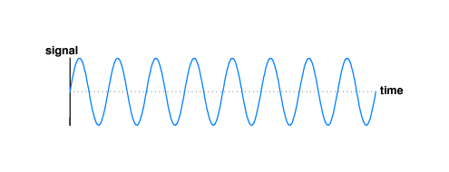
1. Introduction
•Fact: an oscillating signal travels farther than direct current
•For long-distance communication
–Send a sine wave (called a carrier wave)
–Change (modulate) the carrier to encode data
•The frequency of electromagnetic energy determines how the energy propagates
•Frequency of carrier fixed

Slide 3
Analog Modulation Schemes
Modulation: changes made in a carrier
according to the information being sent
Modulation takes two inputs
a carrier
a signal
fundamental characteristics of the wave must be changed to encode signal
primary techniques
Amplitude modulation
Frequency modulation
Phase shift modulation

Slide 4
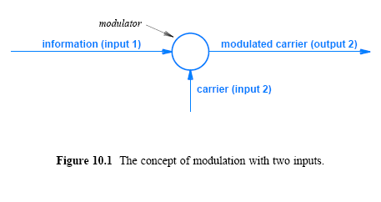

Slide 5
Amplitude Modulation (AM)
AM manipulates the amplitude of a carrier
Results in the changes in the amplitude of the wave
As it is seen from the figure 10.2:
the amplitude (i.e., magnitude) of the sine wave is modified
a time-domain graph shows a shape similar to the signal that was used

Slide 6
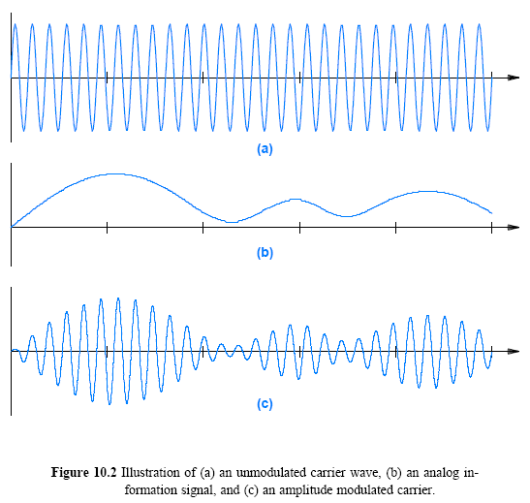

Slide 7
Frequency Modulation (FM)
In FM, frequency changes according to the signal:
For stronger signal, the carrier frequency increases
For weaker signal, the carrier frequency decreases
FM is more difficult to visualize
slight changes in frequency may not be clearly visible

Slide 8
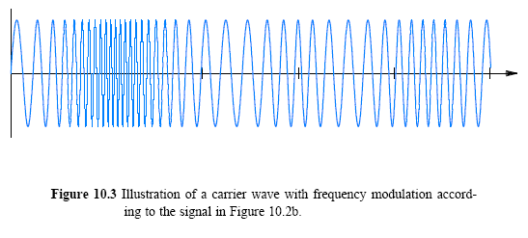

Slide 9
Phase Modulation (PM)
One property of sine wave is its phase,
offset is used to represent reference time from beginning
Changes in phase are possible -> phase shift
phase shift after cycle k
Slight delay between cycle k completion and next sine wave
the delay resembles a change in frequency
PM: a special form of frequency modulation

Slide 10
Amplitude Modulation and Shannon's Theorem
the amplitude of a carrier changes based on modulation index
modulated signal cannot be zero
Shannon's Theorem
If noise is constant
the signal-to-noise ratio will become zero if the signal approaches zero
To get high data rate
the carrier wave must be near maximum
the signal-to-noise ratio remains as large as possible

Slide 11
Modulation, Digital Input, and Shift Keying
Digital schemes use discrete values
To distinguish between analog and digital modulation
shift keying is used rather than modulation
similar to analog modulation
digital shift keying has a fixed set instead of a continuum of possible values
AM allows the amplitude of a carrier to vary by arbitrarily small amounts in response to a change in the signal
amplitude shift keying uses a fixed set of possible amplitudes

Slide 12
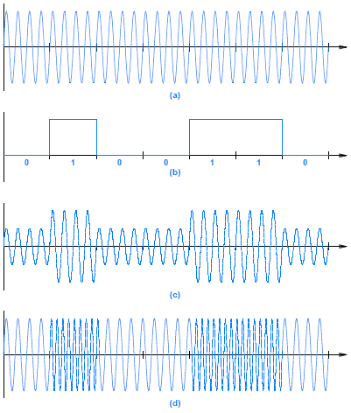
Figure 10.4 Illustration of
a carrier wave
a digital input signal
amplitude shift keying
frequency shift keying

Slide 13
Phase Shift Keying (PSK)
Amplitude and frequency modulations require at least one cycle of a carrier wave to send a single bit
With an exception of special encoding scheme
More bits encoded in a single cycle
More bits can be sent per unit time
PSK changes the phase of the carrier wave abruptly
called a phase shift

Slide 14
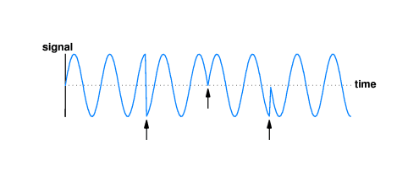
Phase Shift Keying (PSK)
There are three (abrupt) phase changes
A phase shift is measured by the angle of the change
The leftmost portion of sine wave changes its phase by 180 degrees

Slide 15
Phase Shift and a Constellation Diagram
Data encoding using phase shifts
A sender and receiver agree on the number of bits per second
no phase shift may denote logical 0 and presence of phase shift logical 1
Constellation diagram
the exact assignment of data bits to specific phase changes
Many variations of PSK exist
Binary Phase Shift Keying (BPSK) or 2-PSK in Fig. 10.6
Notation of 2-PSK may represent two possible values

Slide 16
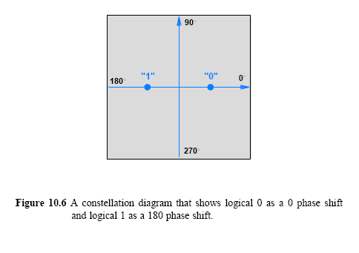

Slide 17
More phase shift keying
More data rate
Measure the amount a carrier shifted
Can recognizes set of phase shifts
each phase shift can represent specific values of data
A power of 2 possible shifts
a sender can use bits of data to select among the shifts
4 possible phase shifts in fig. 10.7
a sender can use 2-bits of data to select among the 4-possible shift values -> 4-PSK mechanism

Slide 18
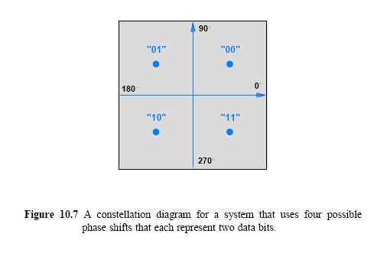

Slide 19
More PSK
In theory, it is possible to increase the data rate by increasing the range of phase shifts
Thus, a 16-PSK mechanism can send twice as many bits per second as a 4-PSK mechanism
Limiting factors: noise and distortion

Slide 20
Quadrature Amplitude Modulation
Motivation: more data rate
Change two characteristics of a carrier at the same time
Combination of ASK and PSK
Quadrature Amplitude Modulation (QAM) or Quadrature Amplitude Shift Keying (QASK)
QAM on a constellation diagram
distance from the origin as a measure of amplitude
Figure 10.8 shows 16QAM with dark gray areas indicating the amplitudes
64QAM and 256QAM are typically used for digital cable television and cable modem applications.
256QAM delivers up to 38Mbps, Wi Fi 5 uses 256QAM and Wi-Fi 6 uses 1014QAM
4096QAM is used for high speed

Slide 21
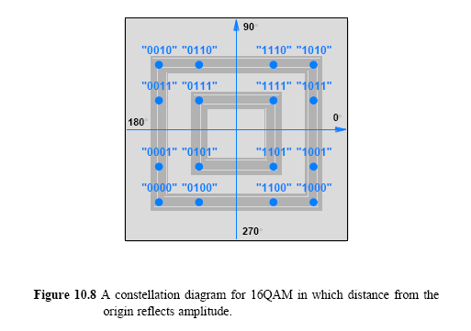

Slide 22
Modem Hardware for Modulation and Demodulation
Carrier and a sequence of bits
Modulator
Demodulator
Transmission of data requires a modulator and a demodulator
Most communication systems are full duplex

Slide 23
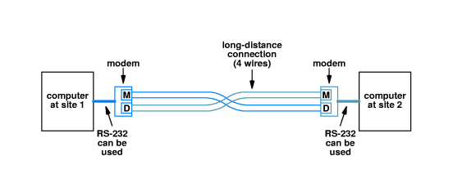
Modem
Used for long-distance communication
•Contains separate circuitry for
–Modulation of outgoing signal
–Demodulation of incoming signal
•Separate wires carry signals in each direction
•Modulator on one modem connects to demodulator on other

Slide 24
Optical and Radio Frequency Modems
Can be used with other media
Radio Frequency (RF)
optical fibers
A pair of RF modems over radio
A pair of optical modems over optical fibers
Regardless of media, the principle remains the same:
modulates a carrier signal with data
data is extracted from the modulated carrier

Slide 25
Dialup Modems
Uses an audio tone
Uses data to modulate an audible carrier
Interior of a modern telephone system: digital
The phone system digitizes the incoming audio
Transports a digital form internally
Converts the digitized version back to analog audio for delivery
The receiving modem demodulates the analog carrier
Extracts the original digital data

Slide 26
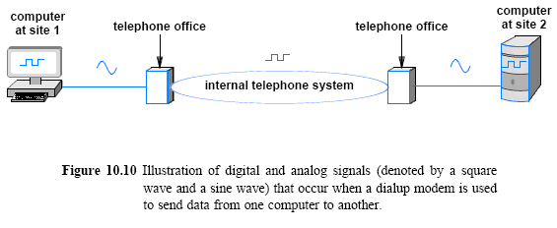
Dialup Modems cont’
The use of analog and digital signals by dialup modems (embedded in a computer) shown below
internal modem / external modem

Slide 27
QAM Applied to Dialup
QAM is used with dialup modems for maximized data rate
Available frequencies between 300 and 3300 Hz
the extremes may not be handled well
use frequencies between 600 and 3000 Hz
the available bandwidth becomes 2400 Hz
A QAM scheme can increase the data rate dramatically

Slide 28
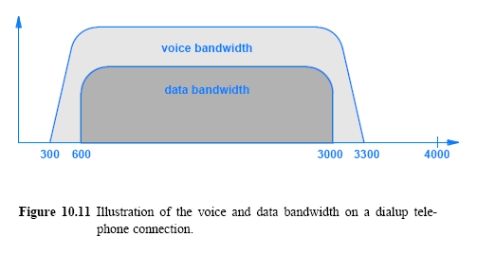
QAM Applied to Dialup

Slide 29
V.32 and V.32bis Dialup Modems
Consider the V.32 and V.32bis standards
Figure 10.12 and 10.13 illustrate the QAM constellation for
a V.32 modem: 32 combinations of ASK and PSK
a data rate of 9600 bps in each direction
a V.32bis modem: 128 combinations of ASK and PSK
a data rate of 14,400 bps in each direction
Sophisticated signal analysis may be needed to reveal the minor change

Slide 30
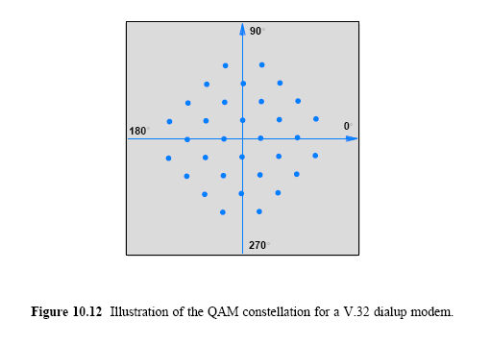

Slide 31
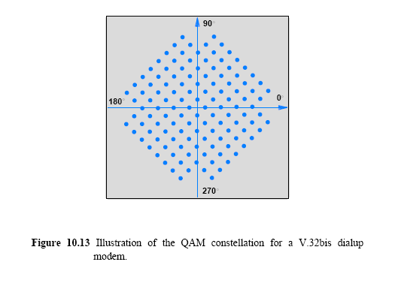

Slide 32
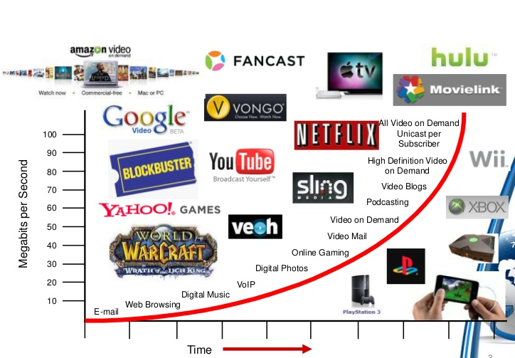
Bandwidth requirements trend

Slide 33
Modem application - Cable networks
Cable networks nowadays provide combined TV and data service using hybrid fiber coax (HFC) cabling architecture
Trunk coaxial cable of legacy networks are replaced by fibers that terminate in fiber nodes
Homes are connected to fiber nodes through coaxial cables fitted with bidirectional amplifiers.
Traditional cable networks were targeted at TV distribution (one-way) and are not suited for 2-way data service – data upstream was provided by dial-up phone but proved not a viable solution.
Digital signaling, two-way amplifiers on coax cables and fiber trunks with greatly increased capacity were introduced in the course of upgrading. Two-way cable networks provide an ‘extended Ethernet’ network that can span up to 100 miles.

Slide 34
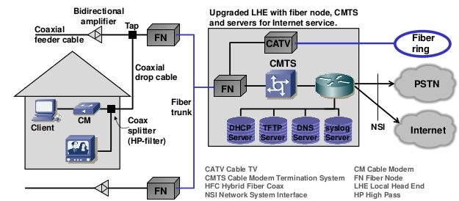
Modem application - Cable networks cont’

Slide 35
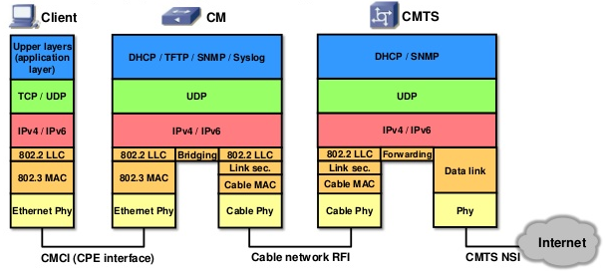
Cable modem
Cable networks employ data over cable service interface specification (DOCSIS) that covers physical layer and data link layer.
Cable modem termination system
Cable modem to
customer premise equipment
interface
Radio Frequency Interface

Slide 36
Cable modem con’t
DOCSIS 3.0 (2006)
Downstream data rate of 160Mbps or higher
Channel bonding
4 or more channels
256 QAM => ~ 40Mbps
8x256 QAM => ~320Mbps
Upstream data rates of 120Mbps or higher
64QAM => ~30Mbps
4x64QAM => ~ 120Mbps

Slide 37
Cable modem con’t
DOCSIS 4.0 (2020)
Downstream data rate of 10Gbps
Channel bonding
4 or more channels
4096 QAM
Upstream data rates of 6Gbps

